Slide 1

WELCOME

Slide 2


Bakery Store Online
Capstone Project Presentation
卒業論文プレゼンテーション

Slide 3
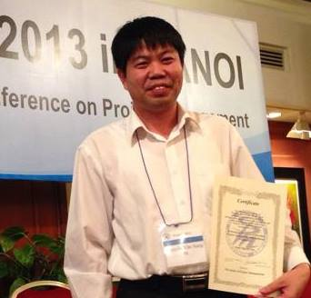
INTRO ABOUT US
Supervisor
指導教員
Nguyen Van Sang

Slide 4





Team Member
チームメンバ
Cao Anh Tuan
Nguyen Xuan Ha
Ngo Trung Kien
Pham Minh Phuong
Hoang Anh Phuong

Slide 5
Outlines -アウトライン
01
02
03
04
Introduction
Project Management
Software Requirement Specification
Software Design Description
導入
プロジェクト管理
プロジェクト管理
ソフトウェア要求仕様

Slide 6
05
06
07
08
Quality Control
Project Result
Demo
Q & A
品質管理
プロジェクト結果
デモ
質問と回答

Slide 7

1. Introduction
導入

Slide 8
03
3
Proposal
02
2
The Idea
01
1
Current Situation

Slide 9

1.1 Current Situation - 現在状況
23 Million
-- Nielsen Việt Nam --

Slide 10
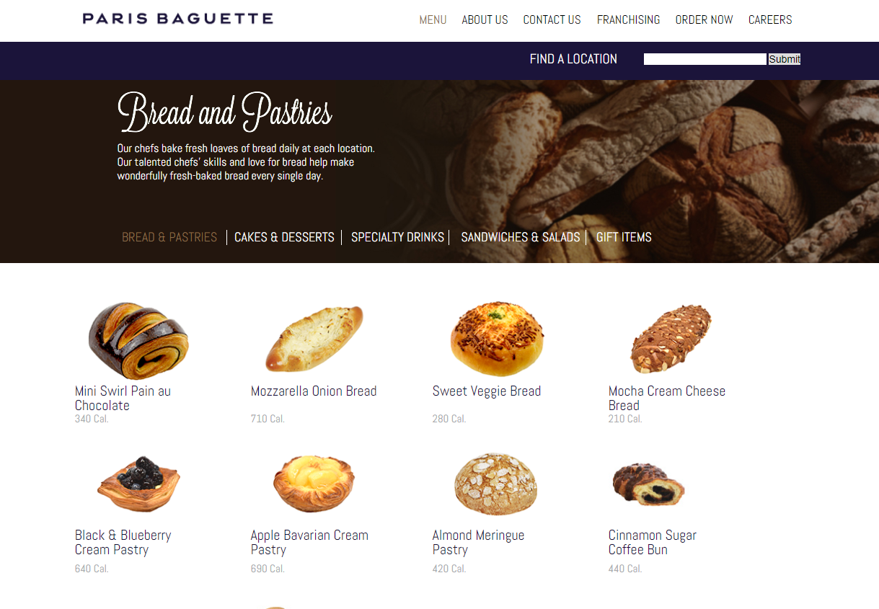

Slide 11
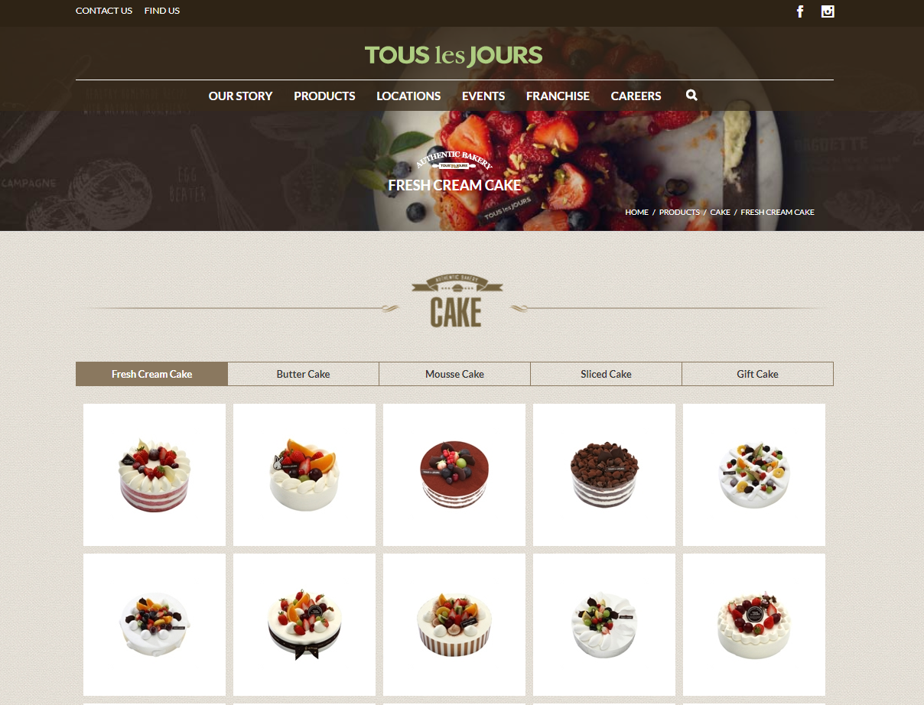

Slide 12
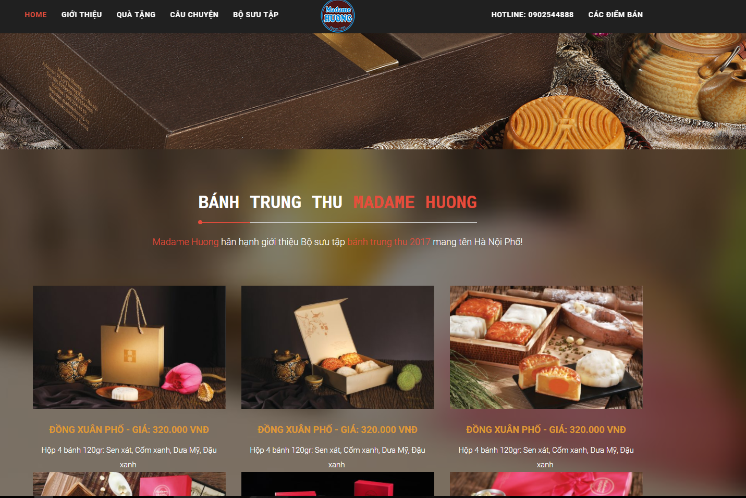

Slide 14
1.2 The Idea - アイデア
Build a website allow
Buy Cakes
Following Promotion Information
How to make a cake

Slide 15
1.3 Proposal - 提案
View and buy cakes
1
Following event and blog of website
2
Build a website
Uses familiar technologies as: Bootstraps, MVC, NodeJS…
3
Proposal
Easy to use
4
Development, management, teamwork skill
1
Improve team member
Technical experience
2

Slide 16

2. Project Management
プロジェクト管理

Slide 17
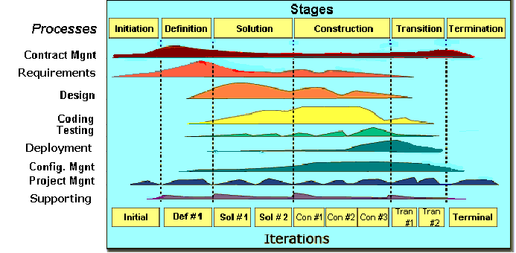
2.1 Software Process Model ソフトウェアプロセスモデル
FPT Software process model

Slide 18
2.1 Software Process Model ソフトウェアプロセスモデル
Initiation | Identify business functions of the system Determine scope, condition, limitation, project risk List main functions Complete Report #1
Solution | Complete SRS, Architecture Design and Database Design Complete Report #2
Construction | Report #3, Report #4 Complete Coding and Testing
Termination | Complete software packages and Report #5, Report #6 Preparing presentation Complete Project
Project Life Cycle

Slide 19
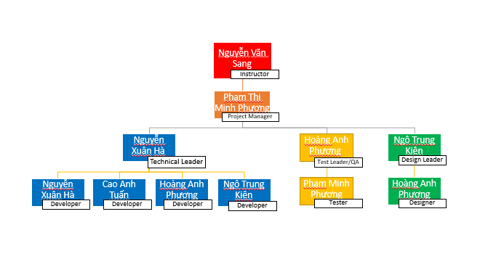
2.2 Project Organization
プロジェクト組織

Slide 20
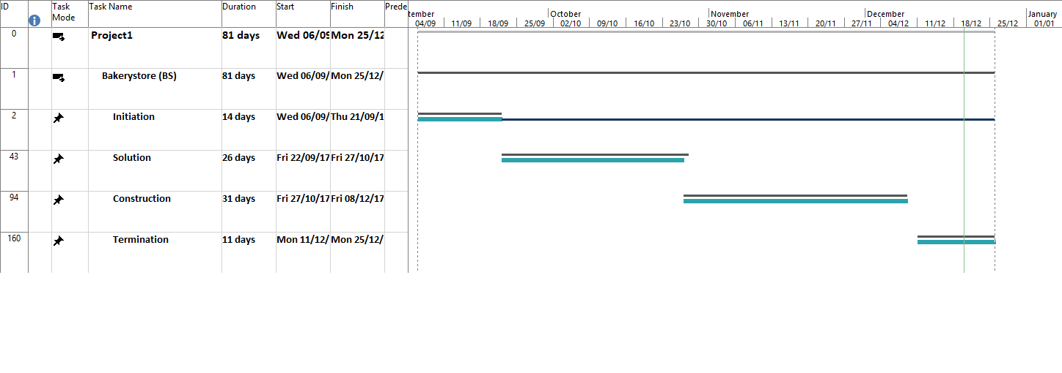
2.3 Project Schedule
プロジェクト計画

Slide 21
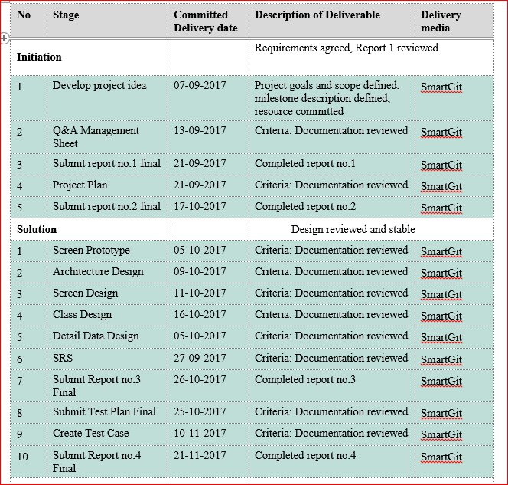
2.4 Objectives & deliverables
目標と成果物

Slide 22










2.5 Tools & Infrastructure ツールと インフラストラクチャ
Tools
Tools for project management
Tools for developing
SmartGit
Word 2013
Excel 2013
Power Point 2013
Astah

Slide 23
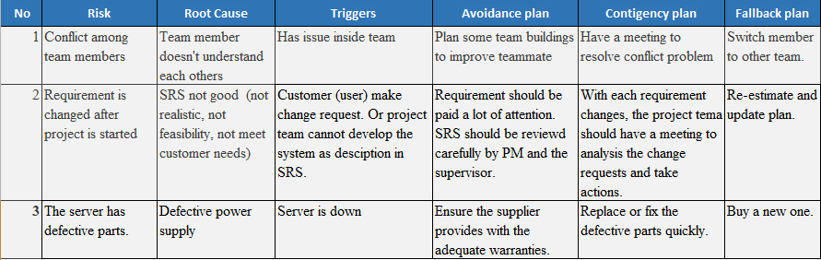
2.6 Risks management
リスク管理

Slide 24
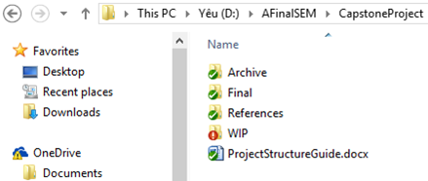
2.7 Configuration management コンフィグレーション管理
Final: Store sent and delivered documents
References: Store reference documents. For example: templates, technologies document…
WIP: Store documents in progress developing
Plan: Plan of capstone project
Users: Working Folder of Member
Documents: Store whole documents in progress developing
Records: Store documents like Meeting Minutes, Q & A Management…
Folder structure of project

Slide 25
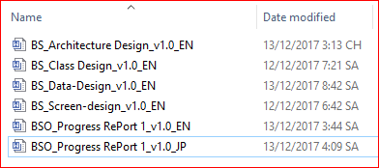
2.7 Configuration management コンフィグレーション管理
Rule: ProjectCode_Document’s name_v<x.x>_language
ProjectCode: FA{
Document’s name: Architecture Design, Class Design…
v<x.x>: document’s version. For example: v1.0, v1.1,…
Language:
EN: English
JP: Japanese
Naming conventions

Slide 26
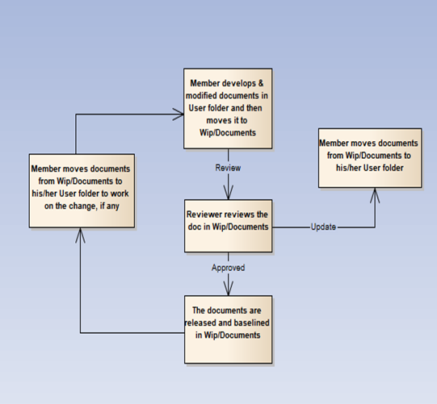
2.7 Configuration management コンフィグレーション管理

Slide 27
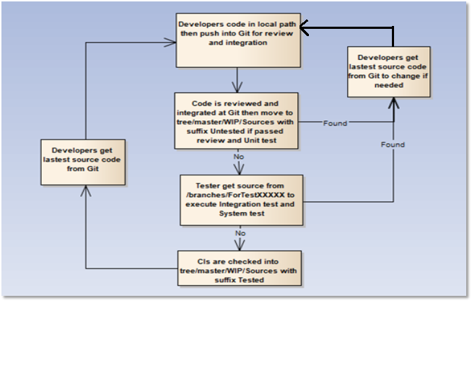
2.7 Configuration management コンフィグレーション管理

Slide 28









2.8 Communication management
コミュニケーション管理
Time: 5 hours/day, 5 days/week.
Location: school, home
Communication
Meeting minutes

Slide 29

3. Software Requirement Specification
プロジェクト管理

Slide 30



3.1 Business Actors -ビジネスアクター
There are 3 actors:
User
Staff
Adminstrator

Slide 31
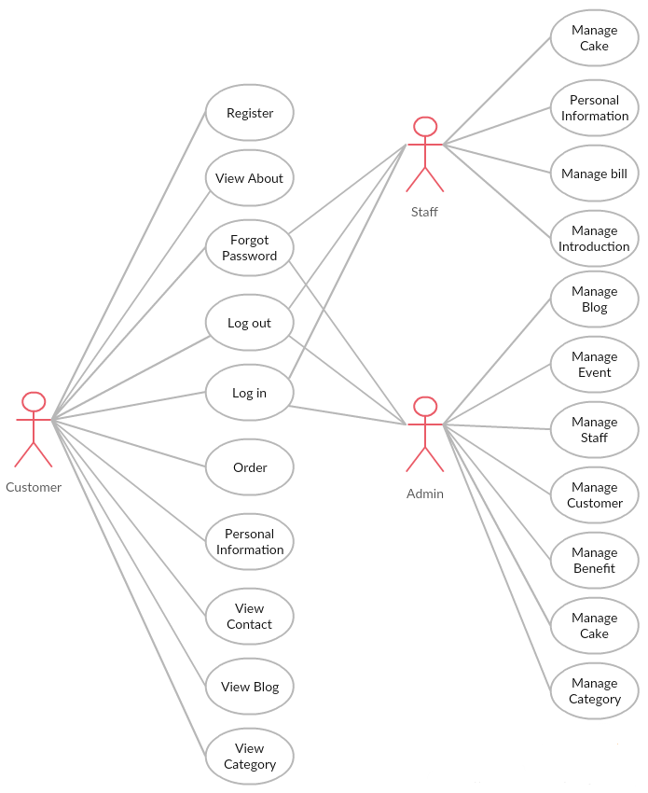
3.2 Functional Requirements - 機能要求
BSO System Module

Slide 32
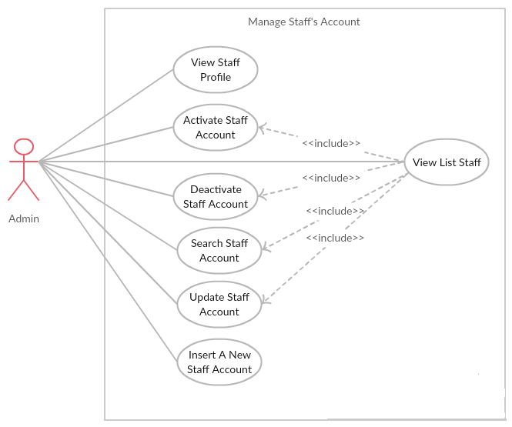
3.2 Functional Requirements - 機能要求
Manage Staff’s Account Module

Slide 33
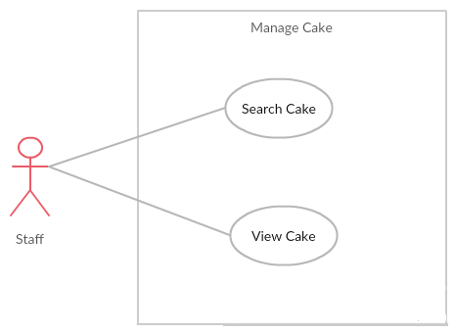
3.2 Functional Requirements - 機能要求
Manage Cake Module

Slide 34
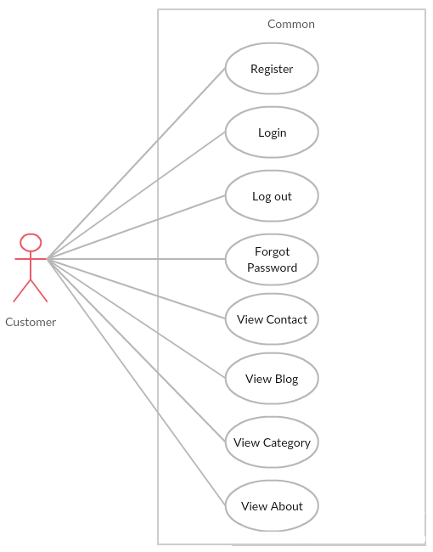
3.2 Functional Requirements - 機能要求
User Module

Slide 35
3.3 Non-functional Requirements - 非機能要求
Availability
The application must be available 95% of time. Users can access to it everywhere from their Web browser with internet connection.
Performance
In term of response time, waiting time of processing will be 8 to 10 seconds; time to process any functions will not exceed 15 seconds.
Maintainability.
Design
The design of the system must be loosely coupled that chances on some module will not affect others.
Usability
- User can complete each function in less than 12 actions
- Output of the project must include coding standards and naming conventions documentations. Implementation code must be easy to maintain

Slide 36
3.3 Non-functional Requirements - 非機能要求
Security Requirements
User authorize
- Each function must be distributed system access and manipulate the individual parts. To edit information, user must declare their username and password before the operation. Functions will be show after users login dependencies user’s role and permission of each user.
Manage Data Layer
- Administrator, staff can modify database system

Slide 37




3.3 Non-functional Requirements - 非機能要求
Software Requirements
Chrome
Firefox
Hardware Requirements:
- PC, Laptop , Smartphone with internet connection.

Slide 38

4. Software Design
Description
ソフトウェア要求仕様

Slide 39
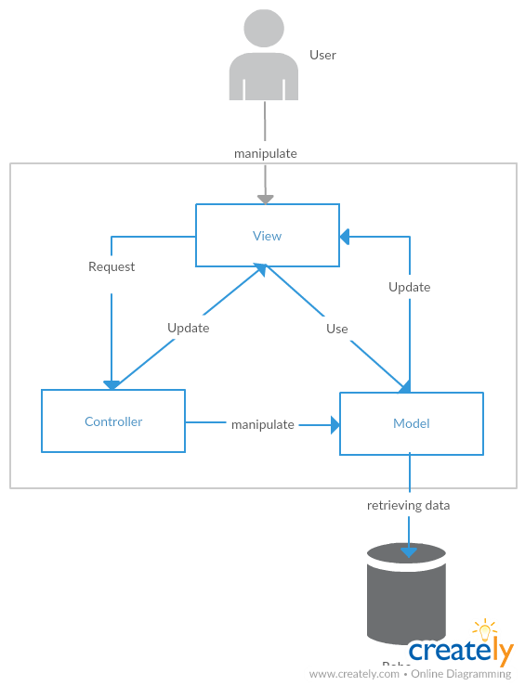
4.1 Architectural Representation –アーキテクチャ表現
Technology:
Nodejs MVC
MongoDB
BS System Overall Architecture
BSシステム全体のアーキテクチャ

Slide 40
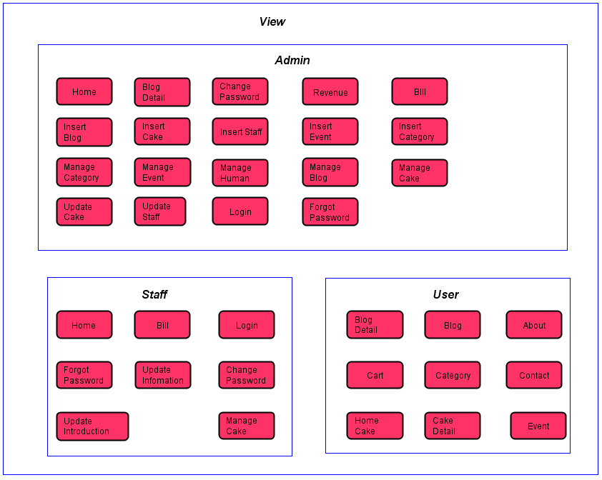
4.2 Package View - パッケージ ビュ
Package View - パッケージ ビュー

Slide 41
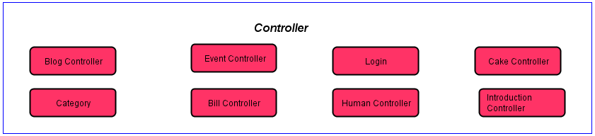
4.2 Package View - パッケージ ビュ
Package View - パッケージ ビュー

Slide 42
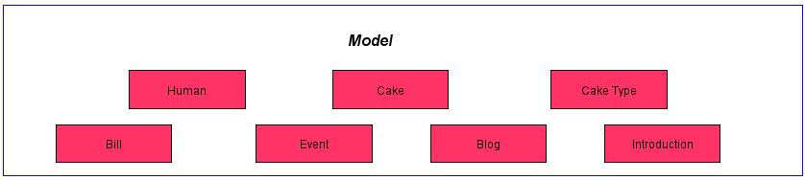
4.2 Package View - パッケージ ビュ
Package View - パッケージ ビュー

Slide 43
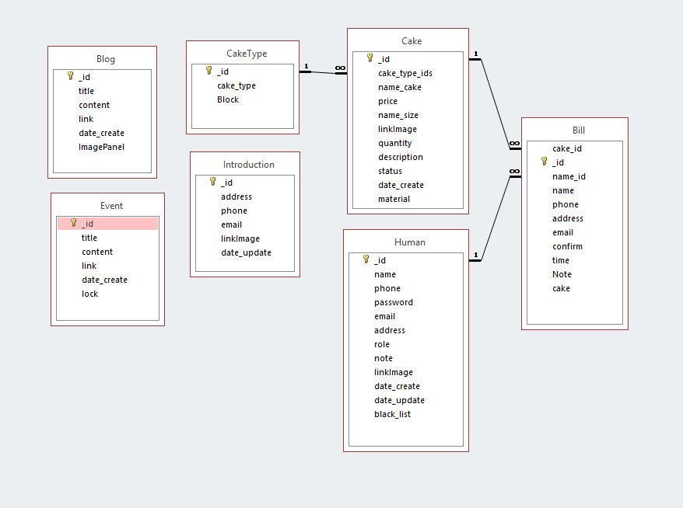
4.3 Database Design -データベース設計

Slide 44
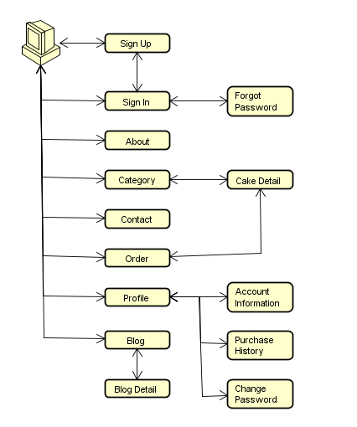
4.4.1 Screen Flow - 画面の流れ
User screen flow

Slide 45
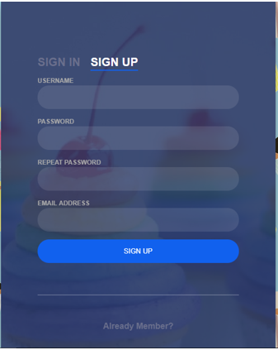
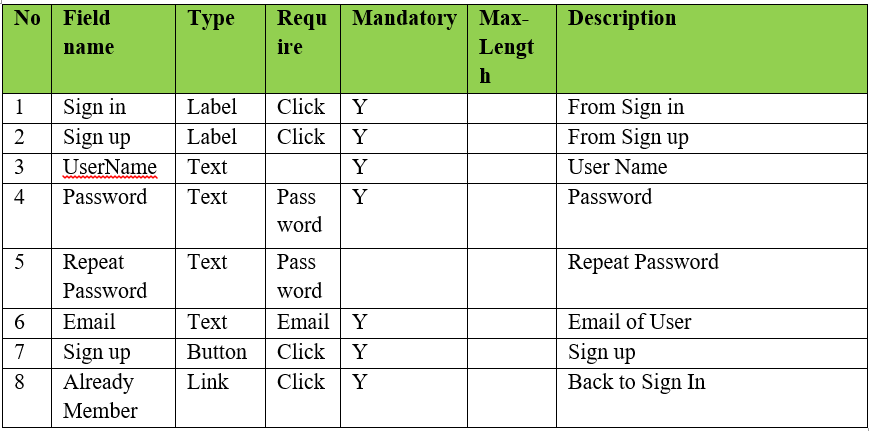
4.4.2 Screen Design - 画面設計
Register screen design

Slide 46
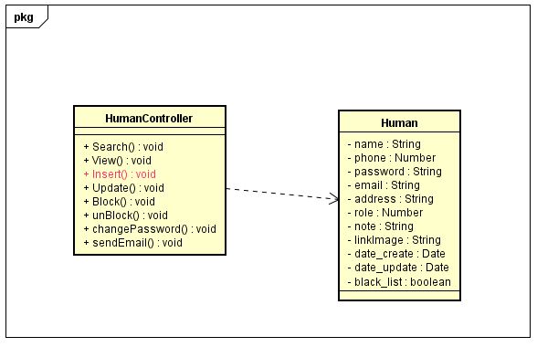
4.5.1 Class Design -クラス設計
Sign Up functions class diagram

Slide 47
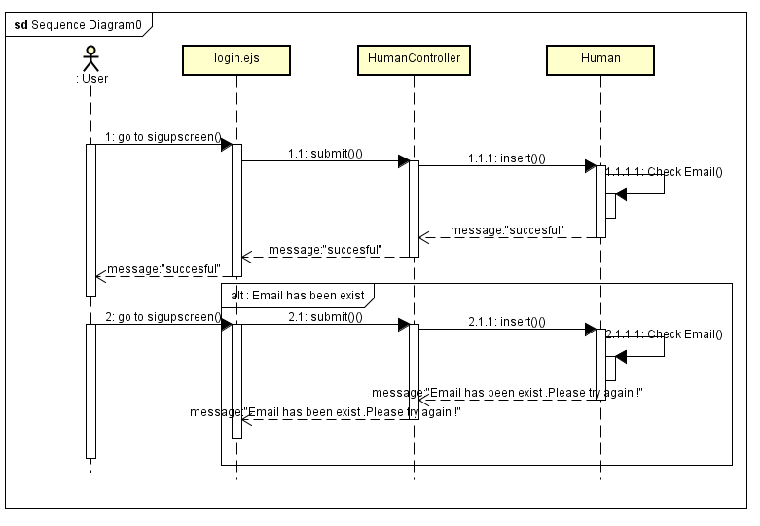
4.5.2 Sequence Diagram -シーケンス図
Register sequence diagram

Slide 48
Quality Control
品質管理

Slide 49
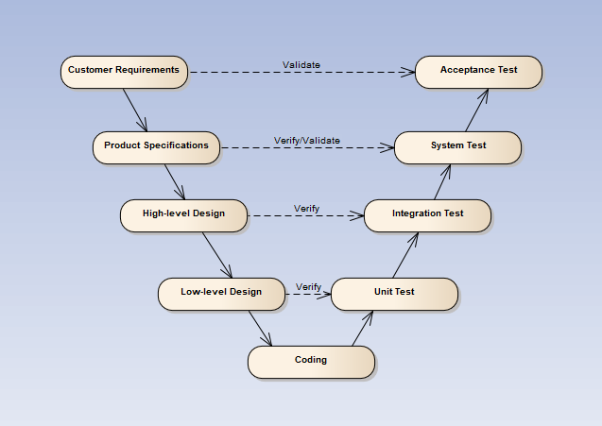
V-model process

Slide 50
5.1 Review
5.1.2 SRS
5.1.3 Design
5.1.4 Code
5.2 Testing
5.2.1Test Process
5.2.2Test Report
5.1.5 Test Document
5.1.1 Project Plan

Slide 51
5.1 Review – レビュー
Self-review
PM review
Peer review

Slide 52
5.2 Test Process
テストのプロセス
Base on Project Plan, Project Schedule , SRS to create test plan:
Features to be tested
Acceptance Test Criteria
Environment
Schedules
Responsibilities
Risks and contingencies
…
1
Create Test Plan
2
5
3
4
Create Test Case
Review Test Case
Execute Test
Create Test Report

Slide 53
5.2 Test Process
テストのプロセス
Test Approach:
Integration Test: Tester
System Test: Tester
Test Environment:
Web :Chrome 40 or above
Firefox 30 or above
1
Create Test Plan
2
5
3
4
Create Test Case
Review Test Case
Execute Test
Create Test Report

Slide 54
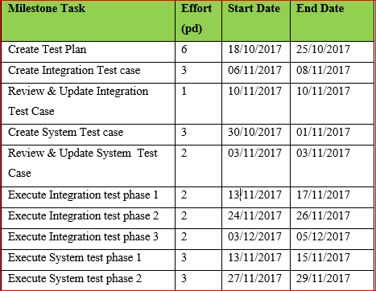
5.2 Test Process
テストのプロセス
1
Create Test Plan
2
5
3
4
Create Test Case
Review Test Case
Execute Test
Create Test Report

Slide 55
5.2 Test Process
テストのプロセス
Base on SRS, create test case:
Integration test case
System test case
1
Create Test Plan
2
5
3
4
Create Test Case
Review Test Case
Execute Test
Create Test Report

Slide 56
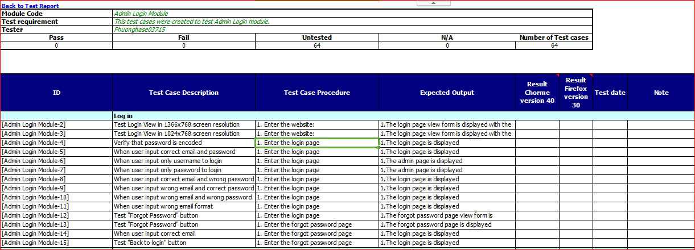
System test case
システムテストケース

Slide 57
5.2 Test Process
テストのプロセス
Tester self-review and peer-review:
Integration test case
System test case
1
Create Test Plan
2
5
3
4
Create Test Case
Review Test Case
Execute Test
Create Test Report

Slide 58
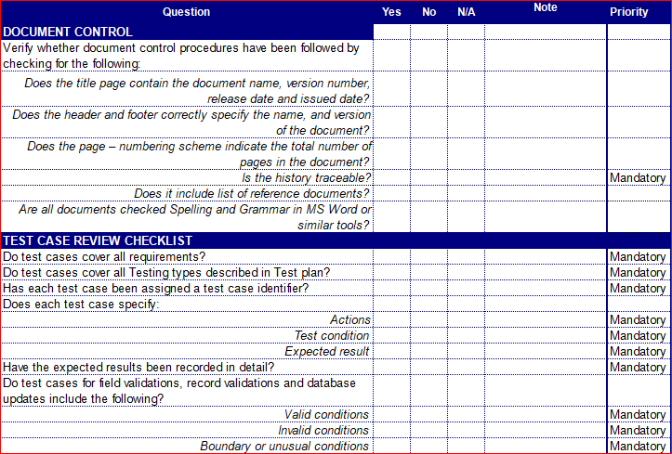
Test case review checklist
テストレビュー

Slide 59
5.2 Test Process
テストのプロセス
Tester execute test case follow phase:
Integration testing
System testing
1
Create Test Plan
2
5
3
4
Create Test Case
Review Test Case
Execute Test
Create Test Report

Slide 60
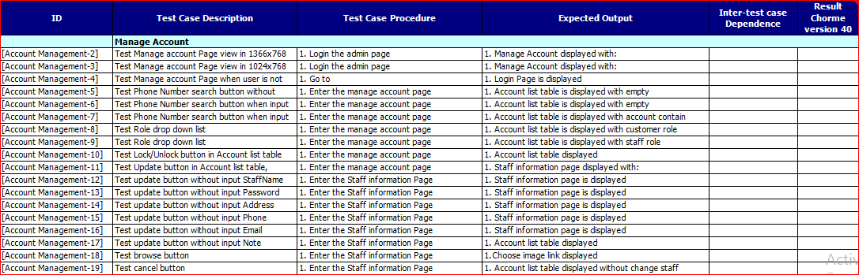
Execute test case
テストケースの実行

Slide 61
5.2 Test Process
テストのプロセス
Tester execute test case follow phase:
Integration testing
System testing
1
Create Test Plan
2
5
3
4
Create Test Case
Review Test Case
Execute Test
Create Test Report

Slide 62
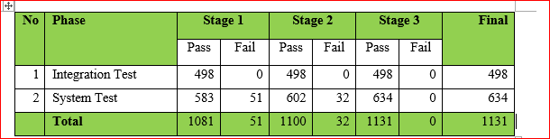
Create Test Report
テストレポートの作成

Slide 63

Project Result
プロジェクト結果

Slide 64
Project summary – プロジェクト要旨
Main objective | Develop a system which will provide to users functionality to buy cake, order online and view product information.
Purpose | Provide a bakery store online on website.
Source repository | https://github.com/sangnvus/201709FallJS01
 | Plan | Actual
Start date | 07/09/2017 | 07/09/2017
End date | 25/12/2017 | 21/12/2017
Release versions | 1.0 | 1.0
Duration | 81 days | 78 days
Efforts (person day) | 405 | 390
Test cases | 1000 | 1131
Defects | 100-200 | 66
Document pages | ~ 1000 pages | ~ 700 pages
Lines of code (nodejs) | ~ 10000 | ~ 12300
Lines of code (HTML) | ~ 5000 | ~ 10000
LOC (Total) | ~ 15000 | ~ 25000

Slide 65
Project summary -プロジェクト要旨
Knowledge:
Work process of FPT Software to develop a project.
Putting the learned knowledge into practice.
Improve skills: teamwork, leader-ship, research and self-study, plan and manage time.
Technical: Heroku, Nodejs, Javascript
Tools: SmartGit, Astah, MS office, Robo 3T, MongoDB, Atom.

Slide 66
Lessons Learnt -学んだ教訓
• The success of a project is largely dependent on the skills and strengths of the people involved. Therefore, a project needs to have a dedicated, talented set of individuals working towards a common goal.
• Always disclose information to those, who will need it. This is not the time or place for obtaining an edge over another by keeping crucial data close to your chest. People, who know what is expected of them and have the means of doing so, will play a pivotal role in making the project a success.
• Be open to change. Sometimes, you may find that the things you knew along may not be correct at this given time, under these specific conditions.
• Good communication is that which will stop mistakes from becoming failures.
• Please think carefully before making a decision because if the wrong decisions you'll have to redo it from scratch.

Slide 67
Limitation & Expectation -制限と期待
Current Limitations | Expectation in Future
Website not support for Vietnamese language. Not support payment methods for people in other contries. Not support payment by mobile cards and bank card. | Support multi-language and other payment method such as visa and master card to get funding from people in other countries. Support payment by mobile cards such as Viettel, Mobi, Vina, … Expand server to inscrease number of users.

Slide 68
7. Demo
デモ

Slide 69
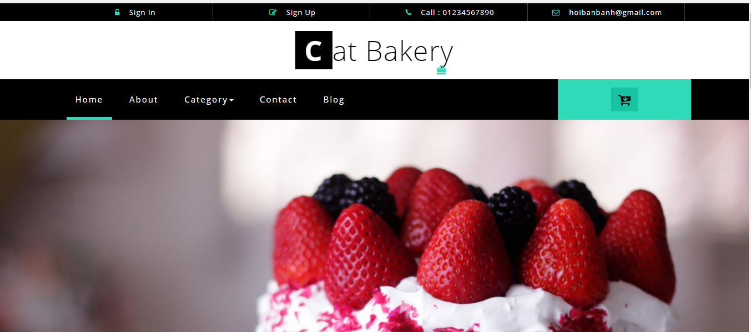
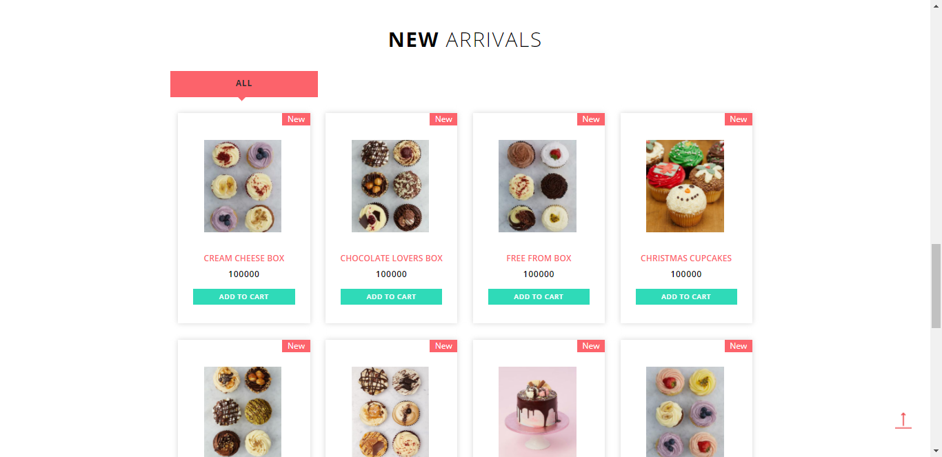
Demo -デモ

Slide 70

Q & A -質問と回答

Slide 71
Q & A SESSION
Q
A
&
THANKS FOR LISTENING
WE’LL BE ANSWERING QUESTIONS NOW

